Slide 1
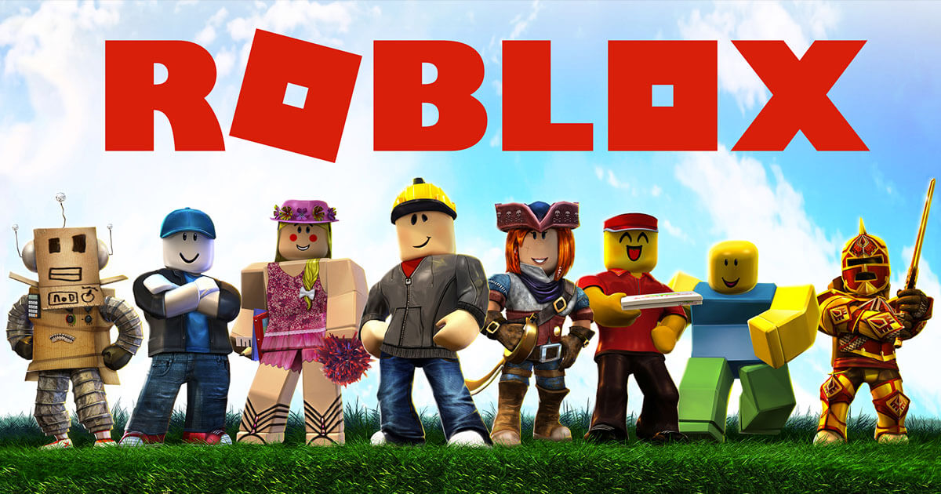
FUNDAMENTALS IN ROBLOX

Slide 2
COURSE TIMELINE
Programming Projects with Lua
Roblox Studio Basics
Constraints Pt 1
Constraints Pt 2
Intro to Lua
Parameters
Loops & Conditionals
Functions
W1
W2
W3
W4
W5
W6
W7
W8

Slide 3

Edmodo
Communication
Directly message teachers
Post Questions
Post Screenshots of your work

Slide 4
TODAY’S LESSON
1
ICE-BREAKERS
2
OBBY GAME
3
ACTIVITY: CREATE OBBY
4
TERM PROJECT!

Slide 5

CLASS RULES
When I’m talking, everyone else is listening.
Treat the instructors and your peers with respect.
Have fun!

Slide 6
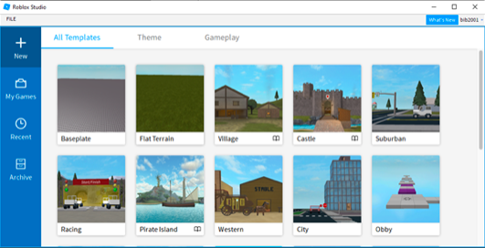
OBBY
Press new
Go to Templates
Select Obby Template
Try Playing the game!

Slide 7
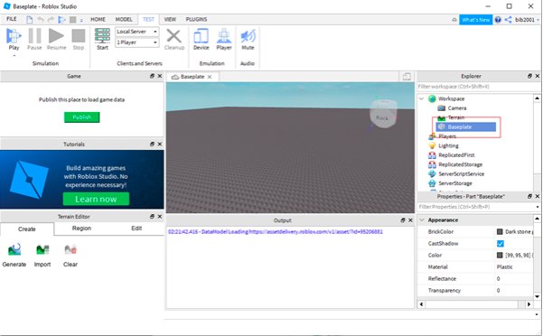
ACTIVITY - LET’S BUILD OUR OWN!
Close the template
Select a base plate template
Go to workspace and click on baseplate. Now press delete.
Create a spawn location. Work space -> spawn location

Slide 8
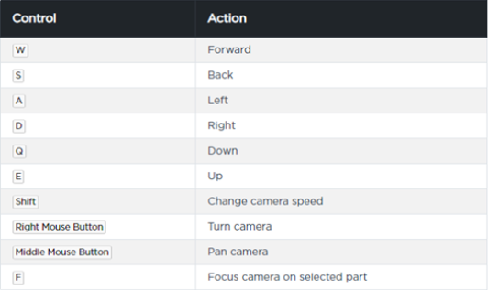
MOVEMENTS

Slide 9
ACTIVITY = OBSTACLE COURSE
BUILDING PARTS
Press the model tab and select parts.
Moving the parts
Collisons should be off
Anchor the parts
Scale the parts
Rotate the parts

Slide 10
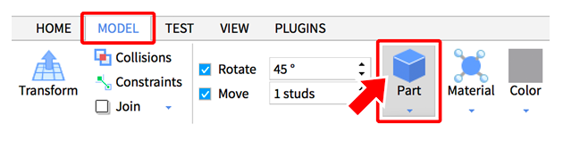
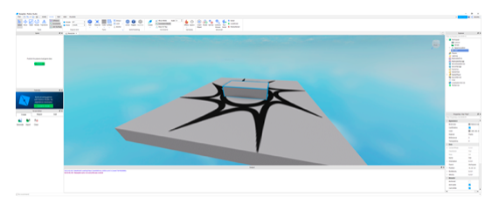
PARTS

Slide 11
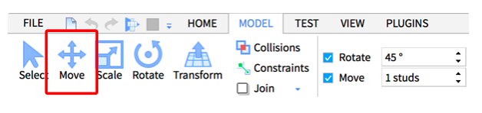
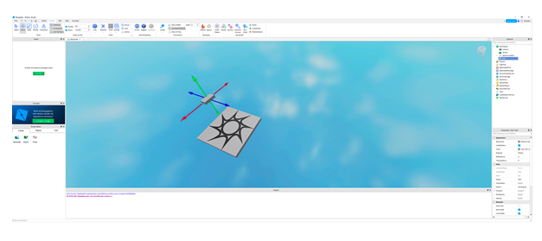
MOVING PARTS

Slide 12
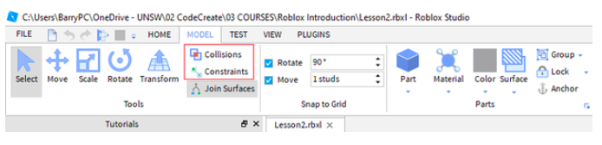
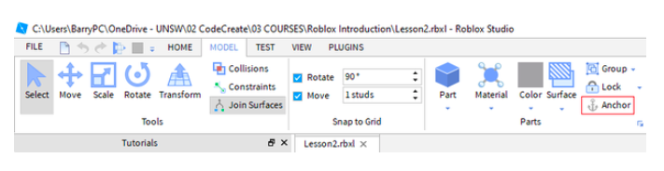
COLLISONS, CONSTRAINTS, ANCHOR

Slide 13
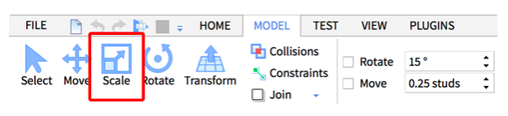
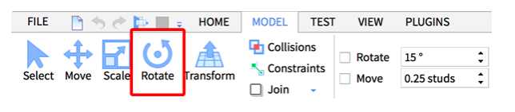
SCALE, ROTATE

Slide 14
CLASS PROJECT

Slide 15
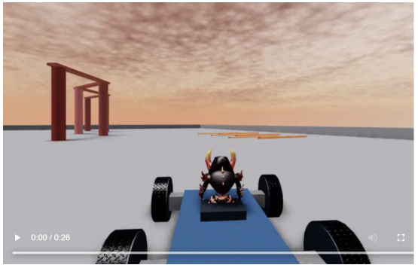
RACING CAR GAME
Notes:
Download the CarKit.rblx Pack
https://developer.roblox.com/assets/blt5d65c328449e57d6/Basic-Car-Create-Cylindrical-Constraint.mp4

